Slide 1




PROJEXEL TECHNOLOGIES Pvt. Ltd.
“Automation Simplified”

Slide 2

What we do?
We are a tech startup of Delhi Technological University, and we have some tech solution for protection of Medical staff who are fighting with #covid19 Pandemic.
Our product is prototyped and tested locally which can be useful to the medical/nursing staff in taking care of the patient with minimum in direct contact with Patient.
For Example:
1. Operating Ventilators from a distance
2. By Providing Wireless call buttons for 4 different services.
3. Reducing cable work for temporary bed setups/Hospitals. Etc.

Slide 3
Team Introduction
Mandeep Sharma
Founder and CEO
Ajay Bhatt
HR & Admin Head
Ravi Kumar
Marketing and Sales
Madhav Sharma
Operational Head
Harsh
Web Developer
Ashutosh
Executive
Sandeep
Accounts and Finance
Chetan Sardana
3D designer
Interns
PCB Designers
Interns
Graphics Designers
Gaurav Gujjar
PCB Designer
Aakash
Executive

Slide 4
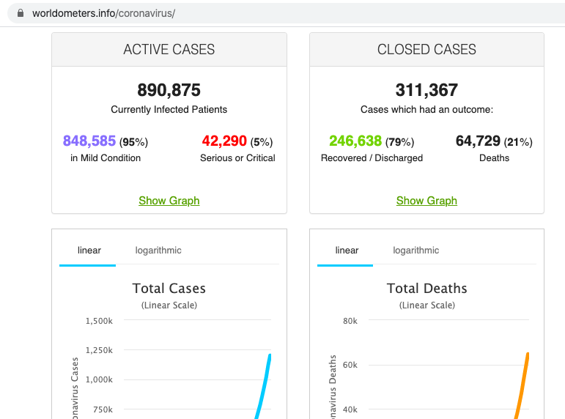
What problem we are solving
Problem:
Covid-19 is a highly contagious disease.
What is the issue with this disease:
As Covid-19 is highly infectable and infectious disease ,it is very dangerous for the nursing staff of the hospital to get in touch with the Covid-19 infected patient, but they have to go near the patient to operate the medical equipment or another essential machines , which should and can be avoid as much as possible.

Slide 5

How Projexel can help
Solution:
Our product RFST (Radio Frequency Smart technology) modules can be used to operate already available medical equipment’s remotely without getting in direct contact with the patient.
(Patent Application Number: 201811049154)
Wireless call buttons can be provided to the patent to call nursing staff for 4 different services.
(Patent Application Number: 201811049154)

Slide 6

How we are solving the Problem
How does it work:
RFST modules work on radio frequency .It have two modules one acts as Receiver and other as transmitter, which can be reprogrammed as per the medical staff's needs by very simple changes, without the requirement of highly trained person.
One product can operate simultaneously 4 channels.
It have 30 meters of range.
256 products can work in 30 meters range without interrupting each other’s functions

Slide 7
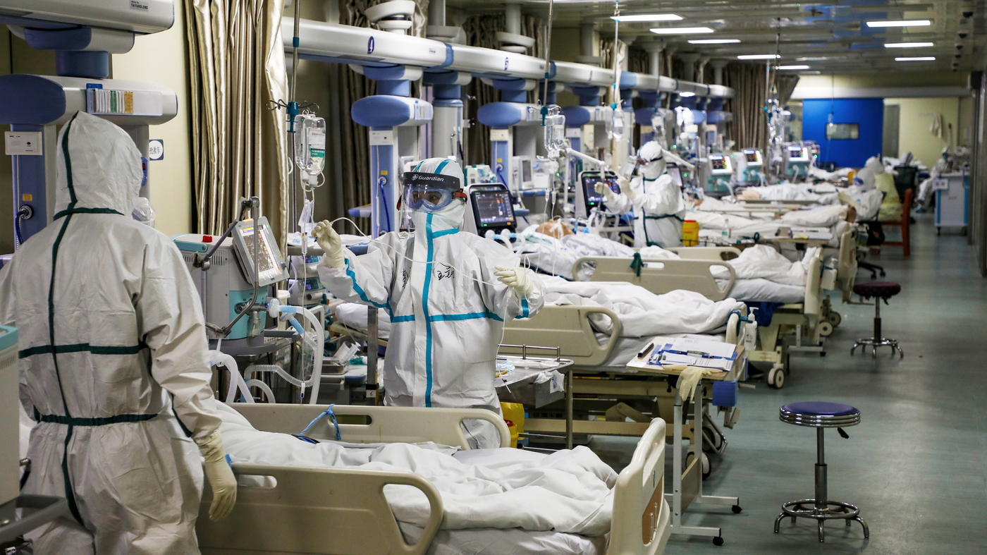
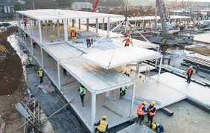
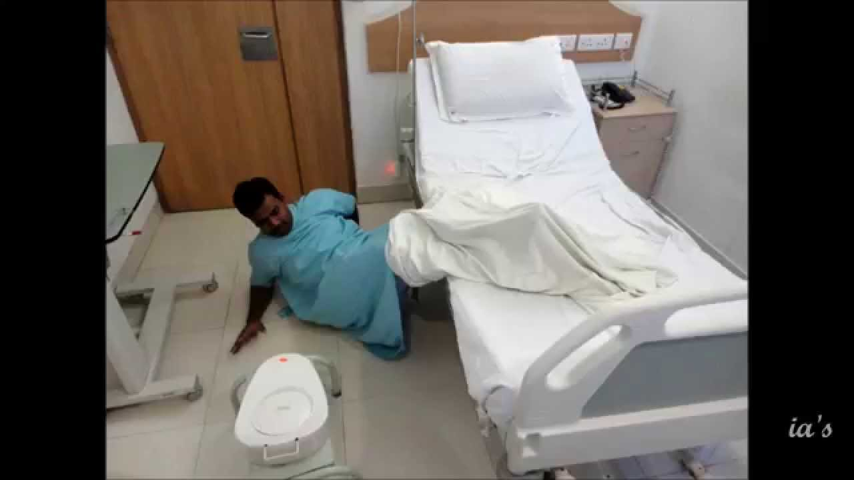
How our product can help to fight the ongoing pandemic
To avoid direct contact with Covid-19 positive patient
To reduce the cable work in temporary hospitals
To provide access to the patient to operate basic operations himself (i.e. lights/fan controls and call buttons for nursing staff with specific messages (Like water, urinal help or any other)

Slide 8
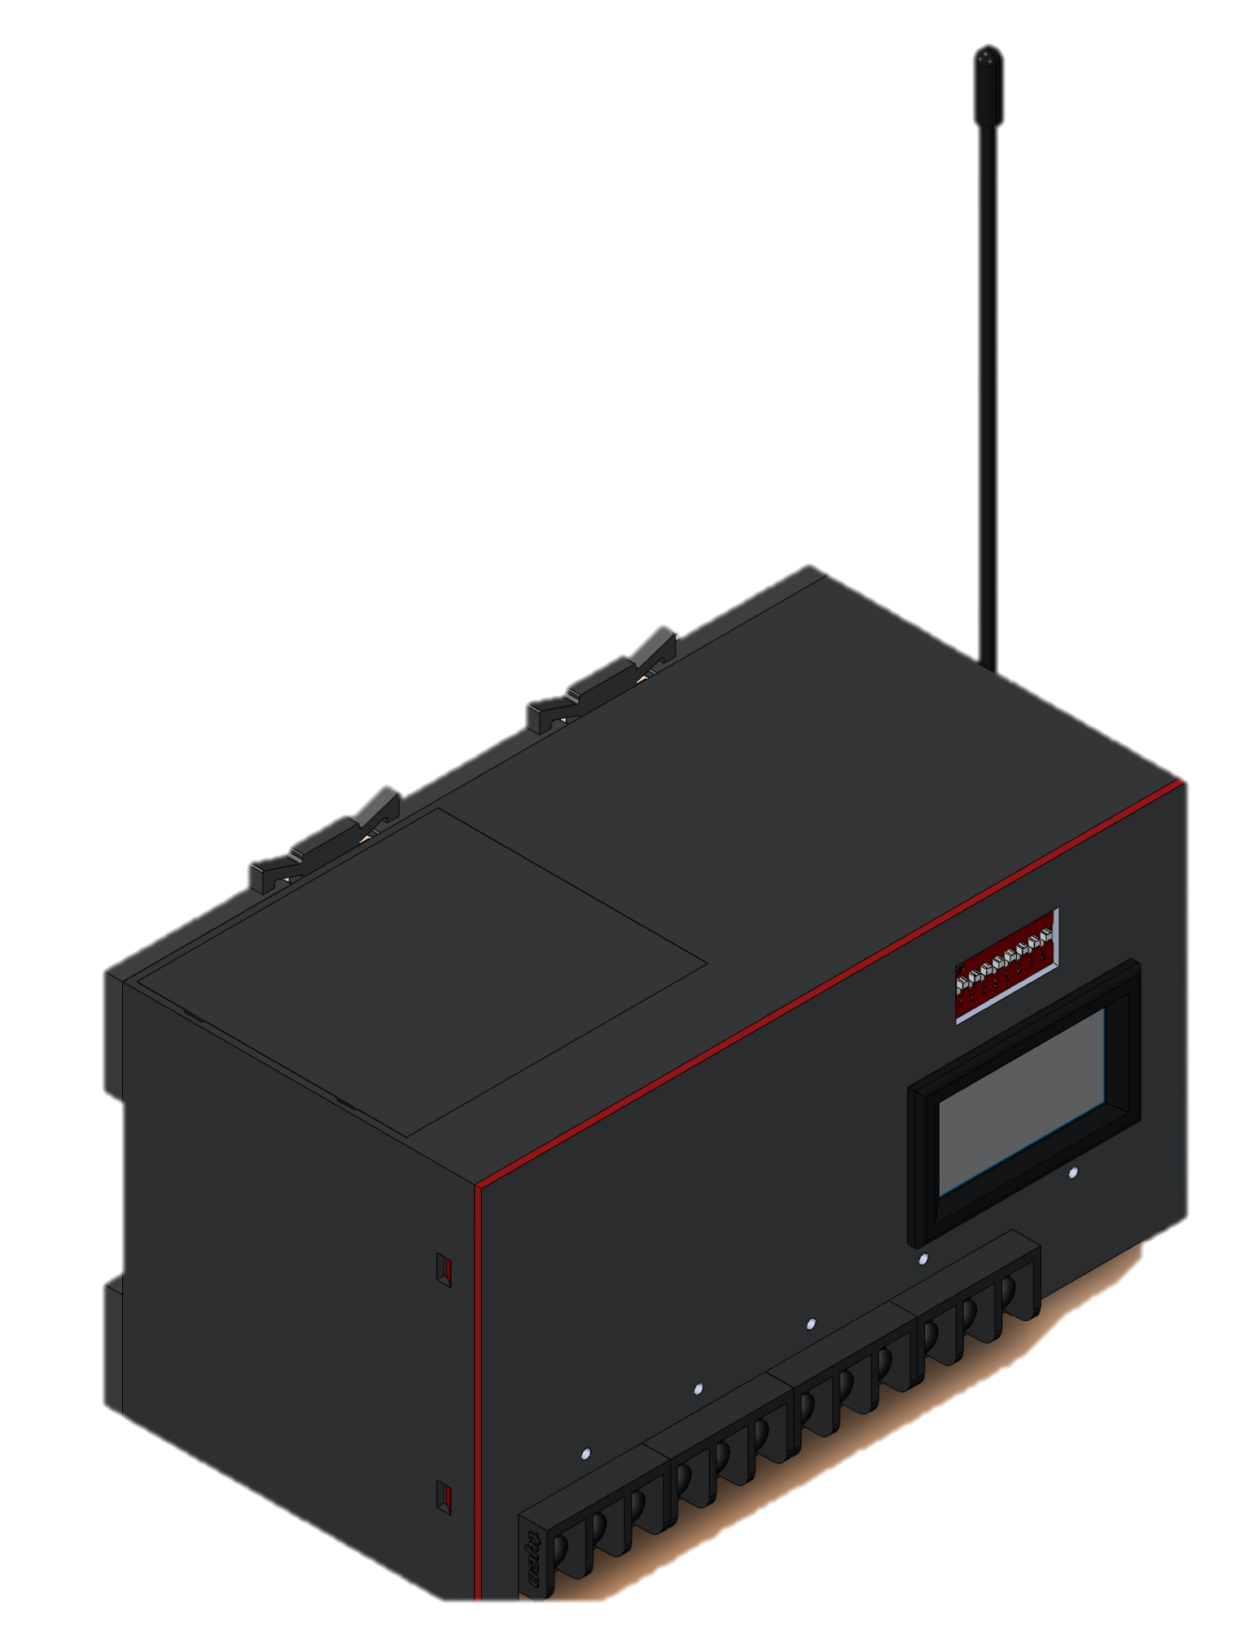
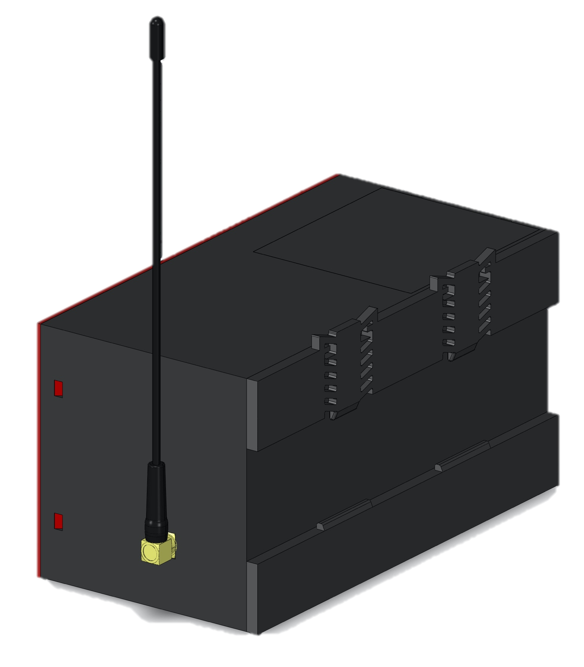
Product Images
Specification | RFST-AR | RFST-AT
Module length, width and height (in mm) | 152 X 77 X 81.5 | 152 X 77 X 81.5
Net Weight
Range | 30 meter
Date transfer speed | 9.6 Kbps | 9.6 Kbps
Communication | One way | One way
Supply voltage | 5-12 VDC | 3-12 VDC
Current usages | 5.5 mA | 40 mA
Modulation | ASK
Sensitivity | - 100 dBm
Battery (Rechargable) | 2800 mAh | 2100 mAh

Slide 9
Financial Predictions
Basic Financial Model
Assumptions Revenue | Year 1 | Year 2 | Year 3
No. of Sold Products | 1000 | 5000 | 20000
Per product price avg. | 10000 | 20000 | 25000
Per product manufacturing cost | 6200 | 8000 | 10000
Operational Expenses /Year
Payroll | 1000000 | 6000000 | 7000000
Marketing | 200000 | 1500000 | 2000000
Outsourced work | 1000000 | 1000000 | 1000000
Sub Total | INR 22,00,000 | INR 85,00,000 | INR 1,00,00,000
Income statement
Net revanue | INR 1,00,00,000 | INR 10,00,00,000 | INR 50,00,00,000
COGS | INR 60,00,000 | INR 4,00,00,000 | INR 20,00,00,000
Gross Profit | INR 40,00,000 | INR 6,00,00,000 | INR 30,00,00,000
GP% | 40% | 60% | 60%
Net Profit | INR 18,00,000 | INR 5,15,00,000 | INR 29,00,00,000

Slide 10
Thank you
Q& A
Mandeep Sharma
Projexel Technologies Private Limited
Contact Us at : Mandeep.attri@ymail.com
8860003363

